Slide 1
The Maze Runner

Slide 2
Table of Contents
01
About our team
Our goal
02
03
Stages of Realisation
Apps/Language that we used
04
05
Block Scheme
06
Future Ideas
07
Demonstration
08
Thank you for the attention

Slide 3
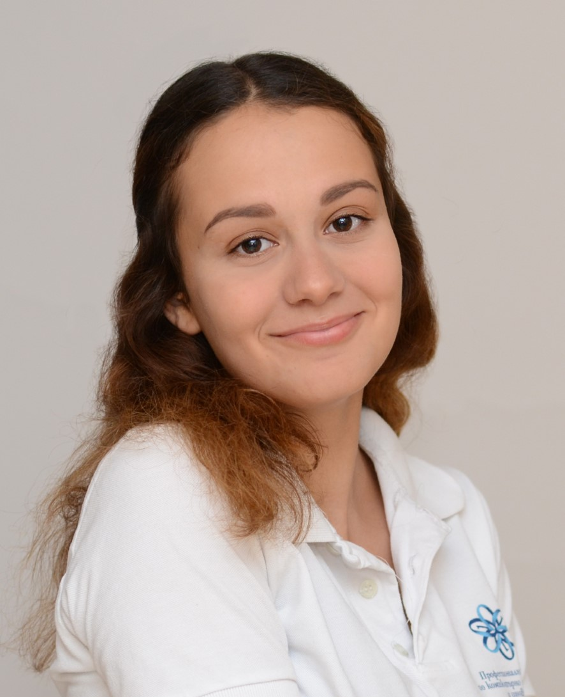
About our teams
Petya Petkova – Scrum Trainer
Dimitar Grudov –
Back-End Developer
Vesela Dekova – Front-End developer
Kameliya Yaneva – QA Engineer

Slide 4
Our Goal
Maze game with three levels and good structured menu

Slide 5
Stages of Realisation
Organisation
Realisation
Presenting the final product

Slide 6





Apps/Language that we used

Slide 7
Block scheme

Slide 8
Future Ideas
To add more levels
To improve the menu
To improve the design

Slide 9
Demonstration

Slide 10
Thank you for your attention

